Slide 1

Enhanced Caesar Cipher
Alpha Bah, Tyra Baxter, Jire Dada, Hamza Amadu, Teron Brown
Group ​1

Slide 2
Enhanced Cipher brief summary (Hamza)
Encryption is the process of securing sensitive information and data by transforming it into converting it into ciphertext by using substitution and complex algorithms. This makes sure that only the intended receiver with the correct key can decrypt the sensitive information.
Strengths:
Data Security
Privacy
Data integrity
Authentication
Weakness:
Complexity: it can be challenging to implement/requires significant computational skills
Key management: managing encryption keys can be difficult
Susceptibility to attack: vulnerability in key storage can lead to security breaches
Performance: higher level encryption can slow down system performance
Historical or modern applications:
Enhanced Cipher has been used for ages in protecting sensitive information it evolved from simple code changes to complex encryption algorithms. during war times messages were encrypted to protect sensitive information to ensure the message gets to and read by intended receiver. In todays time encryption is being widely used in everyday online tasks. AES (Advanced Encryption Standard) encryption is used to secure online banking, messaging, and government data.

Slide 3
How Does Enhanced Caesar Cipher Work?(Teron)
The Enhanced Caesar Cipher encrypts a message by shifting each letter in the plaintext by a varying amount, based on a key.
The key dictates different shifts for each letter, making the encryption more complex. To decrypt the message, the receiver uses the same key to reverse the shifts and restore the original message.
An Enhanced Caesar Cipher is a type of encryption method that builds on the basic Caesar Cipher by adding extra complexity.
An Enhanced Caesar Cipher improves on the basic version by varying the shift for each letter, rather than applying a fixed shift to all letters in the message.

Slide 4
Code HS Enhanced Cipher Result (Hamza)
Encrypted:
hp whhp hkw wd hqwudqfh kruwq hkw ir uiwhd ofkrrv vodvf vkbvlfs
Decrypted text:
Meet me at the entrance north of the school after physics class
Decryption Process:
Put each word in pair (hp whhp)
Flip each pair of words (whhp hp)
Swap first and last letter (phhw ph)
Go back 3 letters in the alphabet (meet me)
A B C D E F G H I J K L M N O P Q R S T U W X Y Z

Slide 5
Encryption and Decryption process(jire)
Encryption can be defined as the process of converting a plaintext into an unreadable(ciphertext) with the help of an algorithm and encryption key to protect unauthorized access into the text(confidentiality)
Decryption is the reverse process of encryption. That is the process of converting the ciphertext into the plaintext.

Slide 6
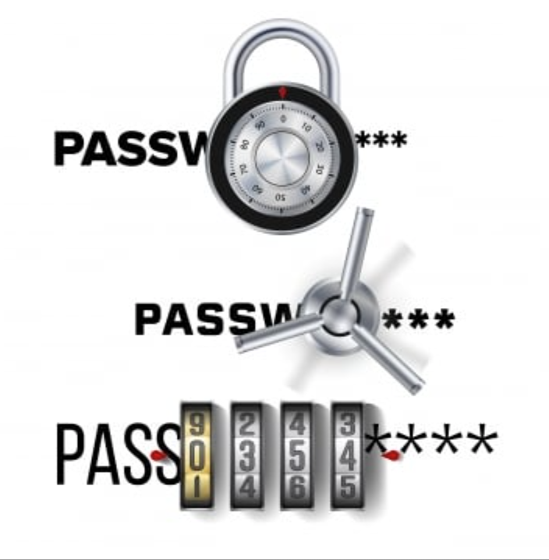
Strengths Of The Enhanced Caesar Cipher
Enhanced ciphers, like AES (Advance Encryption Standards) and RSA, offer strong security with hard to crack algorithms.
Resistant to cryptographic and brute-force attacks by implementing advanced mathematical methods and longer key lengths to guarantee data confidentiality and integrity.

Slide 7

Weaknesses Of The Enhanced Ceasar Cipher
Despite enhanced ciphers strength’s, there are also some drawbacks, for example, a higher level of encryption can lead to slow system performance.
Evolving quantum computing attacks, and difficulties in implementation due to a significant need for computational skills.
In addition, improper key management that is exposed can lead to potential data risks.

Slide 8
General Questions
What is the main purpose of cryptographic ciphers? To ensure security and confidentiality of data
What is the difference between encryption and decryption? Encryption secures data but decryption ensures authorized individuals can access the secured data
How do classical ciphers differ from modern encryption techniques? They differ in complexity, strengths, and application
What is the significance of keys in encryption? Data security, confidentiality, strengths of encryption, versatility in encryption methods, trust/authentication, and non-repudiation
What are the strengths and weaknesses of substitution ciphers versus transposition ciphers?
Substitution cipher strengths are simplicity, speed, and customizability(allows for variations like monoalphabetic and polyalphabetic) to increase complexity.
Substitution cipher weaknesses: vulnerable to frequency analysis(attackers can analyze letter),limited key space is not large enough to resist brute-force attacks.
Transposition cipher strengths: preserve frequency distribution(unchanged letter frequency), increase complexity(rearranging elements may be difficult to detect the pattern by attackers), and customizability allows various keys i.e route transposition for flexible design)
Weaknesses are ease of decryption with a known system(once the transposition method is identified, decrypting the text is straightforward)

Slide 9

Historical Context (Tyra)
The Enhanced Cesar Cipher is variations of the traditional Caesar cipher designed to improve its security. The Cesar cipher is named after Julius Caesar who used this technique to protect his military communications. Over time the concept of enhancing the traditional cipher happened when cryptographers began to see its limitations. The Ceasar Cipher is fairly simple since there is only 25 possible shift values for English letters. Also, common letters like E and A tend to appear frequently in ciphertext.

Slide 10
Enhanced Ceasar Cipher vs Ceasar Cipher(jire) ` jire)
Enhanced Ceasar Cipher
Ceasar Cipher
The Ceasar cipher is a simple encryption technique that uses letter in a plaintext shifted by a fixed number of position in the alphabet
Uses a single, constant shift value (e.g., a shift of 3, so A becomes D, B becomes E, etc.).
Very simple to implement and decode, which makes it vulnerable to cryptanalysis.
Enhanced Ceasar cipher consolidate upon the Ceasar cipher by adding more layers of complexity for data security
The shift may be varied (e.g., different shifts for different letters), or it could involve a more complex key, such as using a key word or a randomly generated number for each letter
More complex, as it may use varying shift patterns, multiple shifts, or additional transformations, adding a layer of difficulty for an attacker.

Slide 11

Modern Application (alpha)
Cryptography has evolved from simple ciphers, like the Caesar cipher developed by Julius Ceaser, for complex algorithms used today. One of the most important developments in cryptography was the Enigma machine used during World War II by the Germans. It encrypted messages through rotating wheels, creating complex ciphers.
Secure Messaging Apps: WhatsApp and Signal use strong encryption called AES-256 to protect messages, ensuring only the sender and receiver can read them.
Online Banking: Encryption is used to secure sensitive data such as passwords and payment details during online transactions, preventing cybercriminals from accessing them.
Cloud Storage Services: Services like Google Drive and ICloud use encryption to protect files stored in the cloud, ensuring only the owner can access them, even if servers are compromised.
In conclusion, enhanced ciphers are essential for keeping data safe in today’s digital world, from messaging to banking and cloud storage.

Slide 12
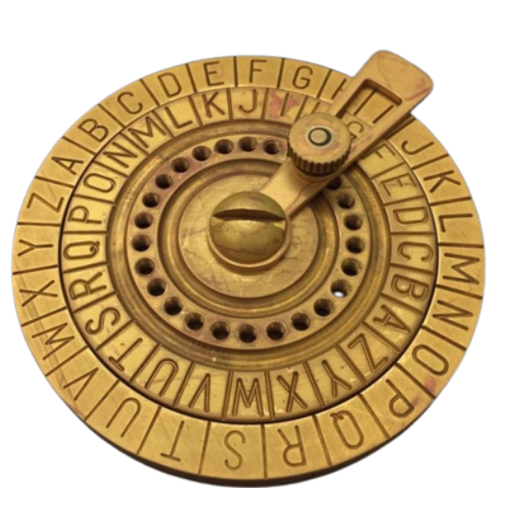
Resistance to Brute Force Attacks(Tyra)
Variable Shifts
Uses different shifts for each letter or group of letters
Keyed Cesar Cipher
A secret key (phrase or random sequence of letters) could be created to determine the shift values
Multiple Layers of Encryption
The cipher text might be encrypted again using a new shift or key following the fist Caesar cipher encryption

Slide 13

How could attackers break Enhanced Ceasar Cipher?(jire)
Frequency analysis: pattern of letter can be used to deduced to shift the key
Brute-force attack: attackers can test all potential keys systematically
Known plaintext attack: common phrase can be compared with the ciphertext to deduced the encryption pattern
Vulnerable key management: stolen key/used pattern can be used to decrypt the ciphertext
Chosen ciphertext attack: attackers could input specific plaintext and observe the result for reverse-engineering

Slide 14
Application Questions
Which cipher would be most suitable for encrypting a short, non-sensitive message? Why?
The Alphabet Cipher is most suitable for encrypting short non-sensitive messages because it is simpler to implement. While enhanced cipher is more complex making it unnecessary for non-sensitive message.
How could combining two or more ciphers increase the security of a message?
Combining two ciphers to an already encrypted message, increase the security of the message because it makes it harder for threat actors to decrypt the message by adding more complicated steps to decryption
What are some real-world scenarios where classical ciphers like these might still be useful?
Classical ciphers are useful in educational settings to teach basic cryptography concepts and in legacy systems that require compatibility with older encryption methods. They can also be employed for lightweight encryption in low-resource environments or for non-critical data protection.
Why are classical ciphers no longer considered secure for modern communication?
Classical ciphers are no longer secure because they can be easily broken using modern cryptanalysis techniques and powerful computing. Their simple algorithms, like substitution and transposition, make them vulnerable to brute-force attacks and rapid decryption, rendering them inadequate for protecting sensitive data today.

Slide 15
References
CodeHS. (n.d.). Learn coding with CodeHS. CodeHS. https://codehs.com
Smith, J. (2020). Cryptography and ciphers: A beginner's guide (2nd ed.). Cengage Learning.

